Slide 1
Dairy and Science

Slide 2
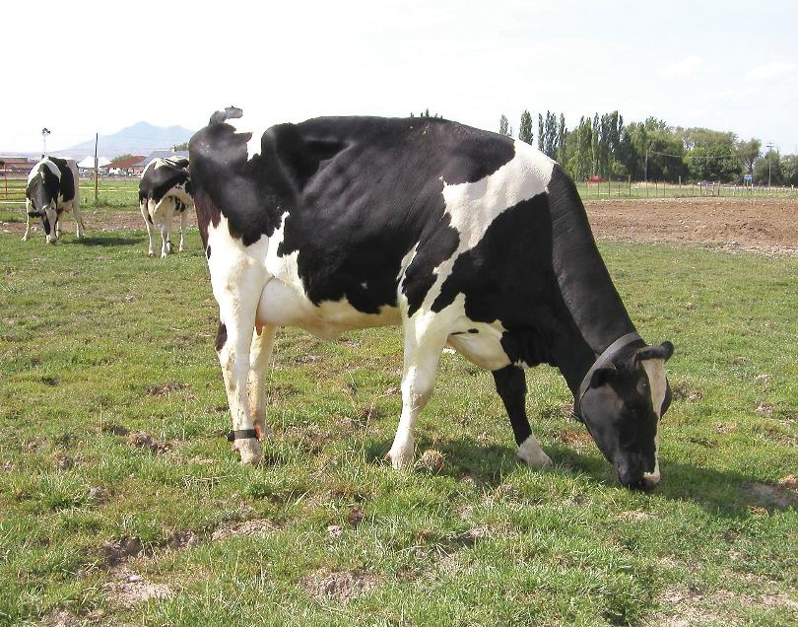
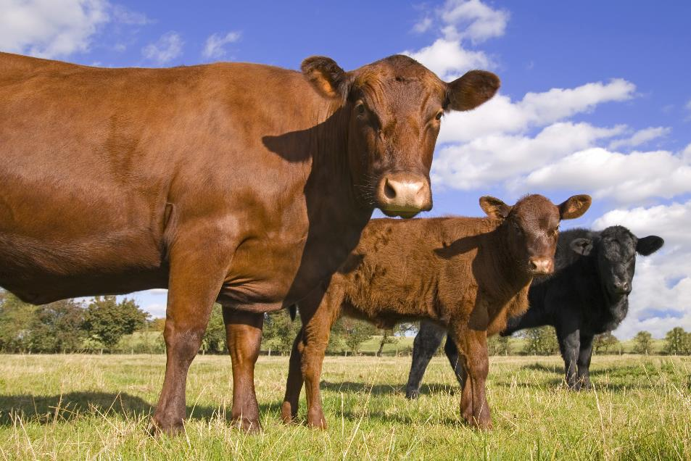
Dairy Cattle vs. Beef Cattle

Slide 3
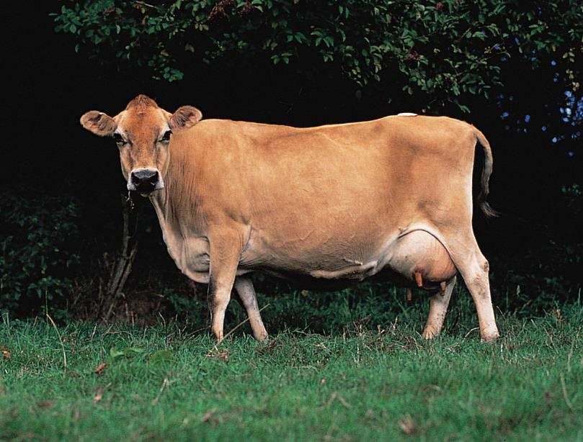
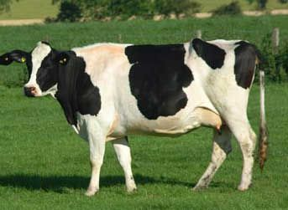
Jersey vs. Holstein

Slide 4
Jersey Cows vs. Holstein Cows
Grandmother
4.75% butterfat
3.6% protein
Mother
4.8% butterfat
3.75% protein
Daughter
4.9% butterfat
3.8% protein
Grandmother
3.4% butterfat
3.1% protein
Mother
3.6% butterfat
3.15% protein
Daughter
3.7% butterfat
3.2% protein

